Slide 1
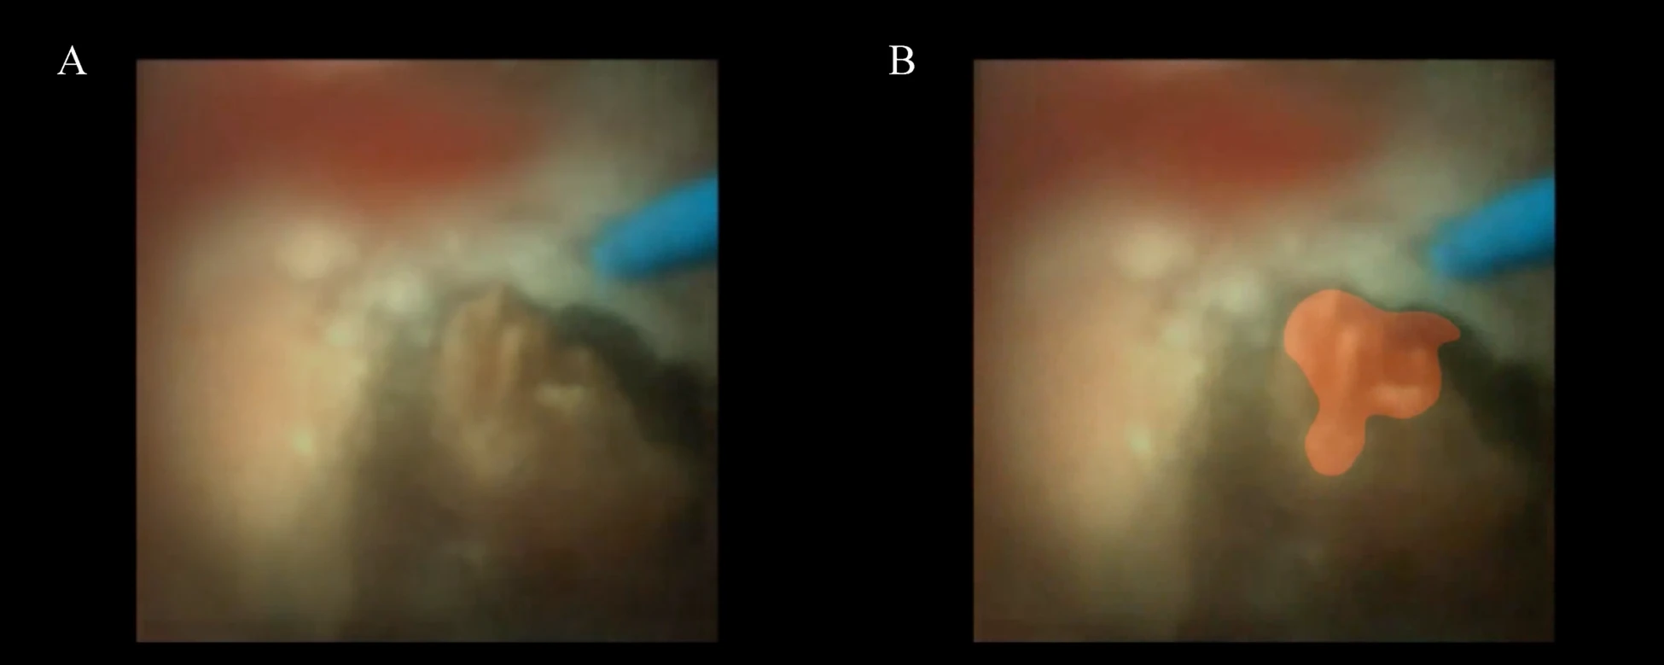
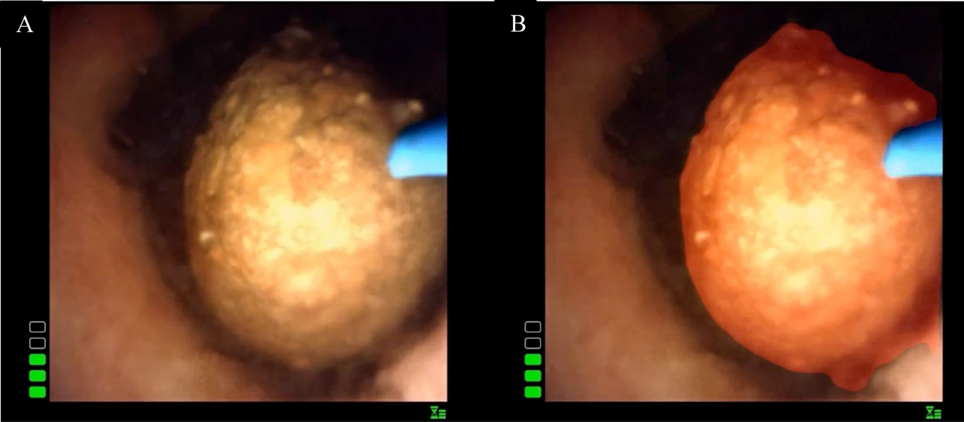
SCIENTIFIC POSTER GALLERY
SCHE 2026
Automated kidney stone segmentation from flexible ureteroscopy videos using a U-net model: A preliminary feasibility study
تجزئة حصى الكلى آليًّا من مقاطع فيديو تنظير الحالب المرن باستخدام نموذج U-Net : دراسة جدوى أوّلية
Joudy Al Ashkar — American University of Beirut · Faculty of Arts and Sciences · Supervisor: Dr. Rida Assaf
Problem / Objective
Method / Design
Results
Conclusion
Ureteroscopy video is degraded by motion, bleeding, dust, and poor lighting
Manual stone identification is subjective, risks incomplete removal
Real-time AI guidance could improve precision, cut surgery time
A U-Net model trained on real surgical footage
Data: 12 ureteroscopy videos (~11 hours), 12 patients, 3 scopes, 4 stone types
Labeling: manual boxes + SAM-generated masks, clinician-verified
Model: 2D U-Net, DenseNet-121 encoder, 1,141 training frames
Split: 8 train / 2 validation / 2 test, by patient
Validation: 94% pixel accuracy, 73% Dice
Test (overall): 92% pixel accuracy, 76% Dice
Test subgroups: Dice was 0.78 in clear frames vs. 0.73 in frames with bleeding, dust, or blur
Speed: ~30 fps, real-time capable
Deep learning can segment kidney stones from real surgical video, a promising first step toward real-time intraoperative guidance.
Performance gaps between training and test results suggest some overfitting, underscoring the need for larger datasets.
Future work: larger, multi-center datasets and integration into live surgical workflows before clinical use.
Syrian Conference for Higher Education 2026 · 22–23 August 2026 · conference.syria-higher-ed-reform.org
Reference: https://doi.org/10.1038/s41598-026-45143-7
Contact: jaa93@mail.aub.edu
Notes:
Flexible ureteroscopy video suffers from motion, bleeding, dust, and inconsistent lighting
Manual stone identification is subjective, risking incomplete removal
Automated visual guidance on real-time surgical video could improve precision and reduce surgery time

